Slide 1
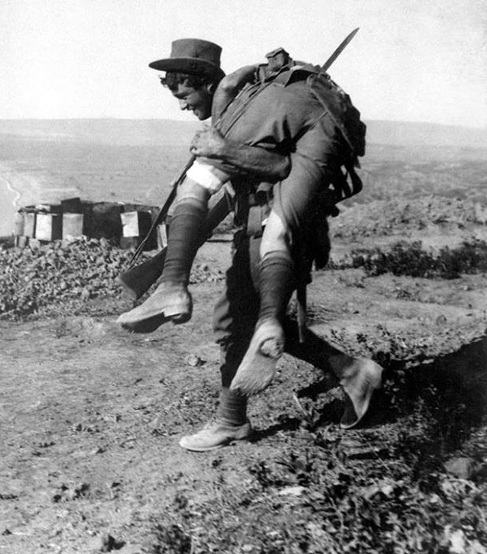
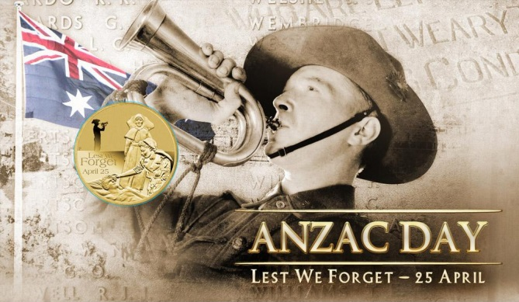
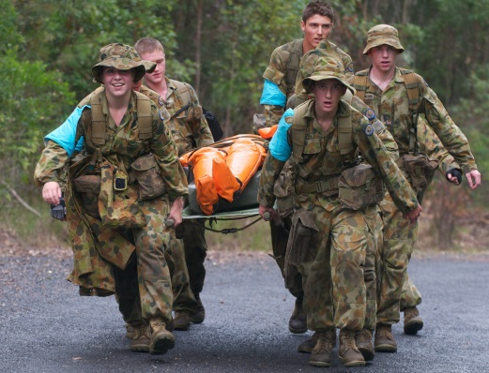
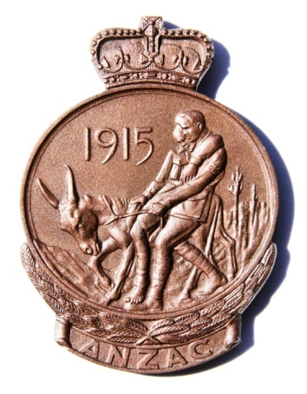
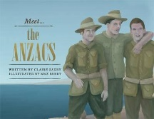
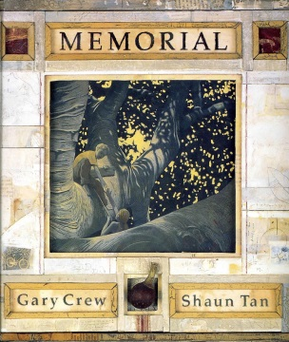
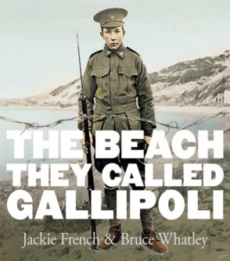
ANZAC
Writing prompts
Leanne Williamson, 2015
Notes:
View for teaching notes:
http://www.google.com.au/url?sa=t&rct=j&q=&esrc=s&source=web&cd=2&cad=rja&uact=8&ved=0CDoQFjAB&url=http%3A%2F%2Fwww.randomhouse.com.au%2Fcontent%2Fteachers%2Fmeet%2520captain%2520cook.pdf&ei=PVHEVNOmJISg8QWT-4C4DA&usg=AFQjCNGRchI8fwrL3nbI4pOO4RQyZqC_gQ&bvm=bv.84349003,d.dGc

Slide 2
ANZAC TED….
Write your own description of ANZAC Ted.
Leanne Williamson, 2015

Slide 3
Literary Recount……….
Write a literary recount of “Meet the ANZACs”
A literary recount gives details about what happened, including who was involved, when and where the event took place, and what may have resulted.
Found : Google Images
Leanne Williamson, 2015
Notes:
What is a literary recount?
A literary recount is similar to a factual recount. Both types of recounts give details about what happened, including who was involved, when and where the event took place, and what may have resulted. A literary recount can be about real or fictional events and characters.
A literary recount is different from a factual recount because it includes more than just facts. A literary recount:
retells a series of events with characters
gives facts and feelings about the events
often uses dialogue between characters
creates an emotional connection with the reader
uses descriptive language.
Examples of a literary recount
Literary recounts include more emotional connections between the reader and the story than factual recounts. Some examples of literary recounts are:
short stories and novels
biographies and letters
fables, myths and legends
plays, films and television programmes
poems and songs
picture books.
Structure of a literary recount
A literary recount must begin with a title or a heading. The title should relate to the text, but can be creative.
The introductory paragraph is called the orientation. In this paragraph the setting and characters are introduced. This may also give the reader a general idea of what the text will be about, or may contain background information that helps to explain the first scene of the text.
The body of the text contains the sequence of events. The sequence of events is usually written in chronological order (the order they occurred). The purpose of these events is to tell the story. This includes what happened, how characters (or people) within the text felt about the events, and how any problems were dealt with.
The concluding paragraph is called the reorientation. This paragraph sums up the recount. This is where the sequence of events ends and any issues or problems are completely resolved by the characters. The emotional responses of the characters involved may also be included in this s
Source: http://www.skwirk.com/p-c_s-6_u-124_t-340_c-1179/WA/6/Literary-recountsLiterary-text-typesText-typesEnglish/

Slide 4
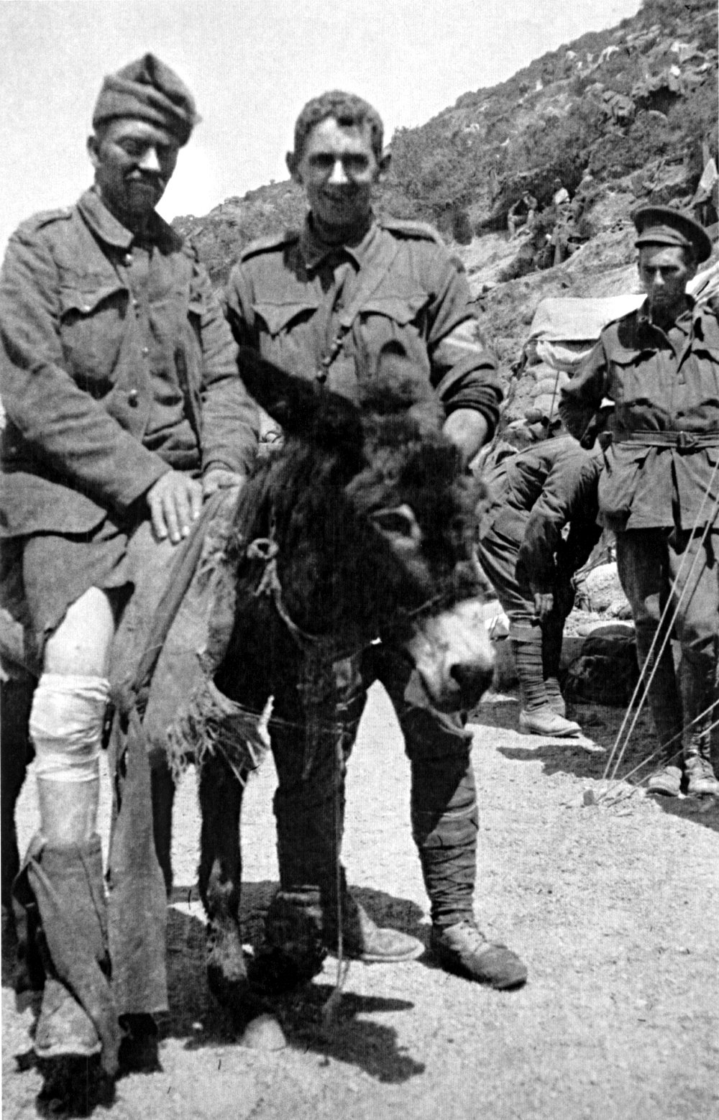
Simpson and his Donkey……..
Simpson and his donkey appear on the ANZAC Medal which was awarded to every Anzac soldier who served on the Gallipoli Peninsula.
Perhaps you think it is not right to give this donkey such a prominent place in ANZAC history…. after all it is only an animal. Maybe a soldier and a nurse should be on the ANZAC medal. What are your thoughts?
Found : Google Images
Leanne Williamson, 2015

Slide 5
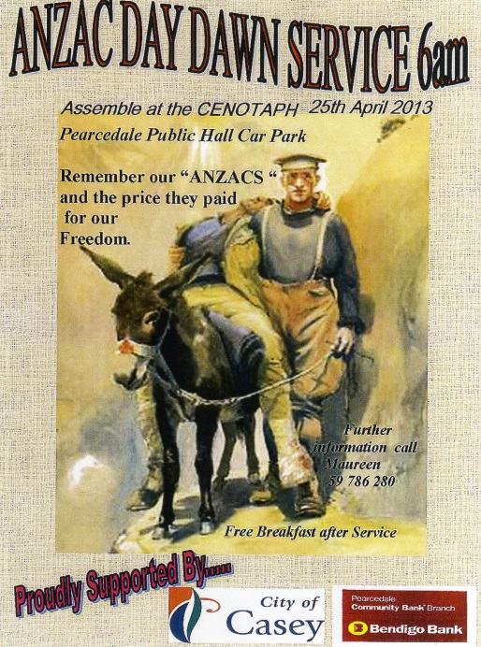
ANZAC Day Poster
Using what you know about ANZAC Day, Gallipoli or anything else to do with our brave servicemen and women design your own commemorative poster to honour the ANZACs.
Found : Google Images
Leanne Williamson, 2015

Slide 6
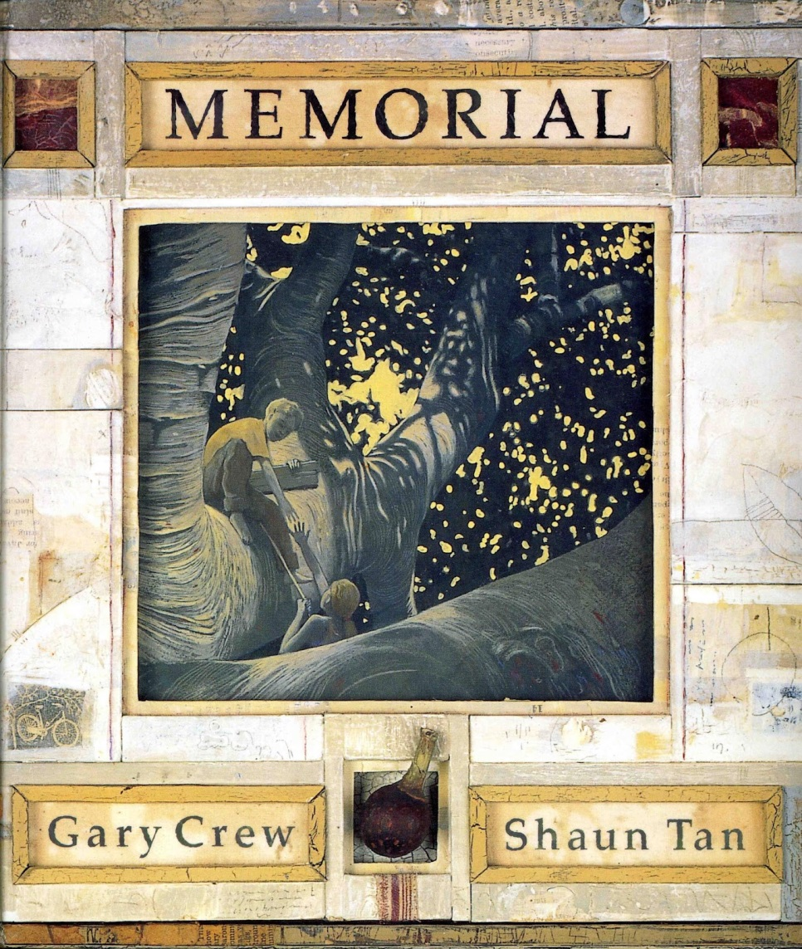
Memorial by Gary Crew & Shaun Tan
Write a short piece, in your own words, about what you learnt from
this story.
Found : Google Images
Leanne Williamson, 2015

Slide 7
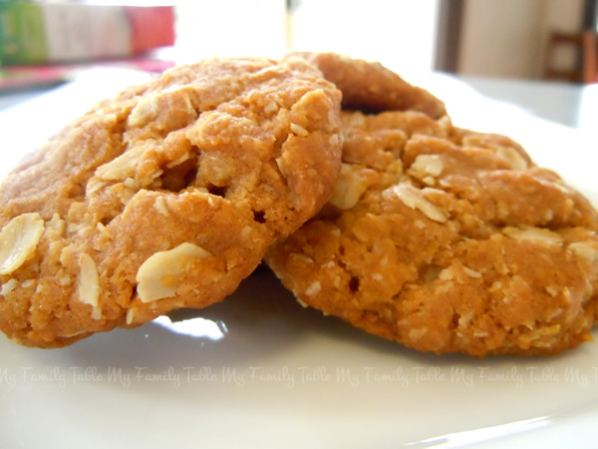
ANZAC Biscuits: Procedure
Write a procedure for ANZAC Biscuits.
Found : Google Images
Leanne Williamson, 2015
Notes:
Make these with students before you write about it.
Ingredients:
1 cup plain flour
1 cup rolled oats
1 cup desiccated coconut
3/4 cup caster sugar
1 teaspoon finely grated lemon rind
125g butter
2 tablespoons golden syrup
1 teaspoon bicarbonate of soda
1 tablespoon boiling water
Method:
Step 1
Preheat oven to 180°C/160°C fan-forced. Line 2 baking trays with baking paper. Sift flour into a bowl. Add oats, coconut, sugar and lemon rind. Stir to combine. Make a well in centre.
Step 2
Place butter and golden syrup in a microwave-safe bowl. Microwave on high (100%) for 30 seconds or until butter has melted. Stir to combine. Combine bicarbonate of soda and boiling water in a bowl. Add to butter mixture. Stir to combine. Add to flour mixture. Stir to combine.
Step 3
Roll level tablespoons of mixture into balls. Place balls, 3cm apart, slightly flattened, on prepared trays. Bake for 13 to 15 minutes, swapping trays halfway during cooking, or until golden. Stand on trays for 5 minutes. Transfer to a wire rack to cool. Serve.
Sourced: http://www.taste.com.au/recipes/24550/anzac+biscuits

Slide 8
Mateship
It is thought that the famous Australian ‘Mateship’ had its origins at Gallipoli where soldiers fought alongside one another with courage and sacrifice.
Describe what could be happening in this picture.
Then think about one of your closest friends and write a paragraph about what makes him or her such a good mate.
Found : Google Images
Leanne Williamson, 2015
Notes:
Lesson sourced from ANZAC Written by Ron Shaw.
https://australianteacher.files.wordpress.com/2011/10/anzac-book.pdf

Slide 9
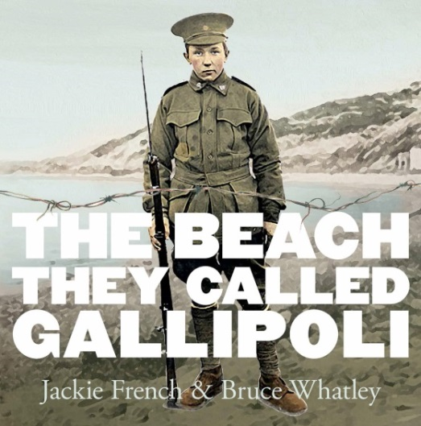
Book Review…
Write a review of this book. Include:
The book’s title and author
A brief summary of the plot that doesn’t give away too much
Comments on the book’s strengths and weaknesses
The reviewer’s personal response to the book with specific examples to support praise or criticism
Found : Google Images

Slide 10
World Peace Treaty…..
All the world’s nations agree to sign a peace treaty.
How might they agree to work in harmony with one another and prevent future wars from occurring? Write agreements in point form below (try to think of a least 5).
Here is an example:
We respect and tolerate each others ‘religions and not see any religion as superior to any other.
Found : Google Images
Leanne Williamson, 2015
Notes:
Lesson sourced from ANZAC Written by Ron Shaw.
https://australianteacher.files.wordpress.com/2011/10/anzac-book.pdf

Slide 11
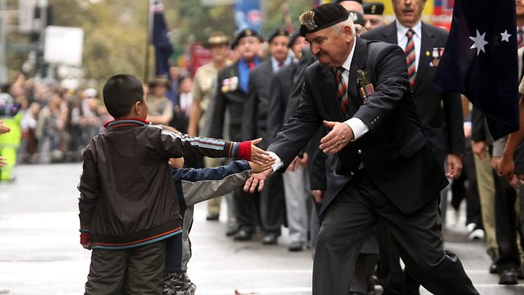
Tell the story about what was happening when this picture was taken.
http://www.dailytelegraph.com.au/thousands-turn-out-in-the-rain-for-sydneys-anzac-day-dawn-service/story-
Leanne Williamson, 2015

Slide 12
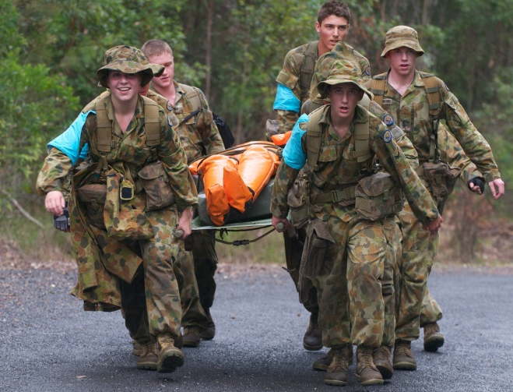
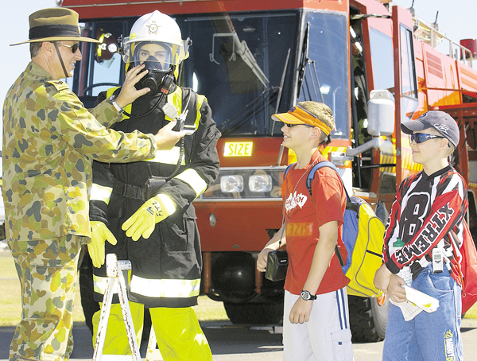
It is important to spend more money on the Australian Army!
What do you think about this statement? Write to persuade a reader to agree with your point of view.
Think about:
• if you agree or disagree or if you can see both sides of the topic
• an introduction – clearly say what you think about the topic
• your opinions – give reasons or examples to explain them and be persuasive
• a conclusion – a summary of your main points and a final comment on your opinion
Remember to:
• plan your writing before you begin
• make your writing interesting to read
• write in sentences and stay on the topic
• check your spelling and punctuation
• use words that will persuade your reader
• start a new paragraph for each new idea
• check and edit your writing when you are finished
Found : Google Images
Leanne Williamson, 2015

Slide 13
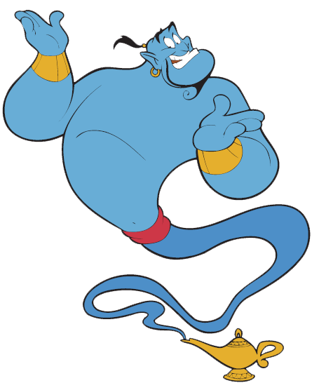
The Genie who brought World Peace!
Write a poem or short story called “The Genie who brought World Peace’.
Found : Google Images
Leanne Williamson, 2015
Notes:
Lesson sourced from ANZAC Written by Ron Shaw.
https://australianteacher.files.wordpress.com/2011/10/anzac-book.pdf

